Slide 1
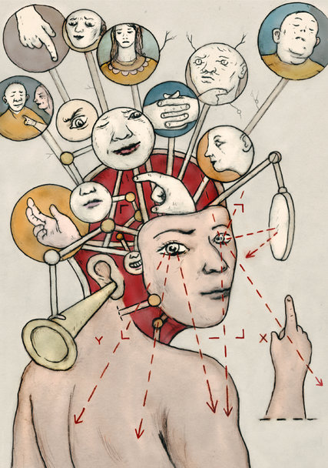
The Brain

Slide 2

What does your brain do?
Thinking!
Using your senses
Moving your body
Sleeping and dreaming
Feeling emotion

Slide 3
What is your brain made of?
The brain is made up of special cells called neurons
These neurons have their own way to talk to each other and send messages through the brain and even to the body

Slide 4
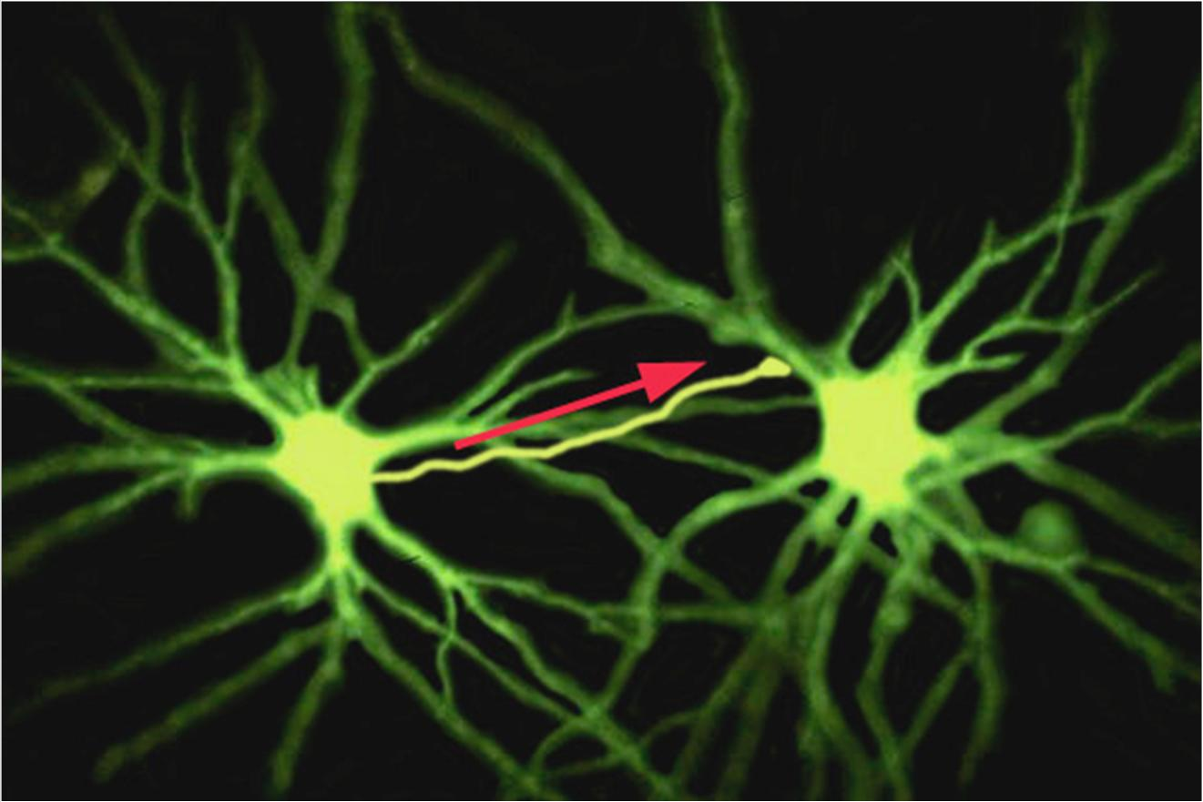
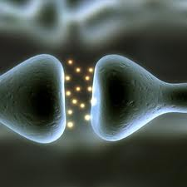

Slide 5
How many neurons do you think are in the brain?
10,000
1,000,000
100,000,000
100,000,000,000
1,000,000,000

Slide 6
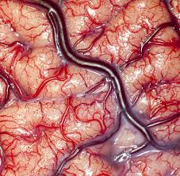
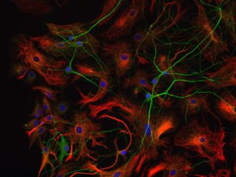
But there’s more!
The brain is also made up of lots of glial cells…
…and lots of blood vessels!

Slide 7
What do the different parts of the brain do?
Each section of the brain has a specific job
Some areas are specialized to do just one thing, like to see or to smell
Other areas get information from all over and combine it into one message

Slide 8
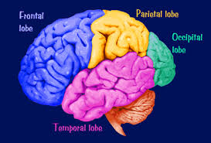

Slide 9
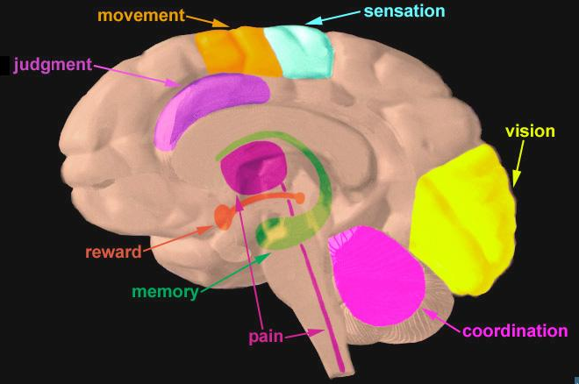

Slide 10
Brain control of the body
The brain controls everything your body does
Interestingly, the left side of your brain controls the right side of your body.
And, the right side of your brain controls the left side of your body.

Slide 11
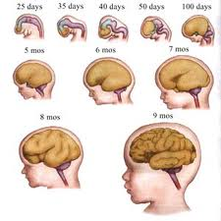
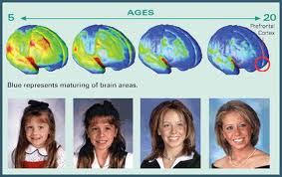
As you get bigger, so does your brain!
Your brain continues to grow and change throughout your life.

Slide 12
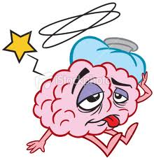
How do we know all of this?
When a part of the brain stops working, we can observe problems with functioning.
Damage or disease in specific areas of the brain can cause unique changes in health and behavior that allow us to understand what different parts of the brain do.

Slide 13
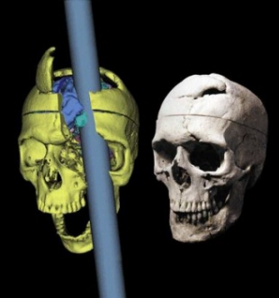
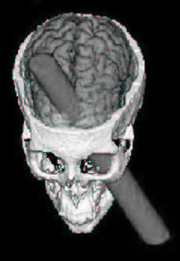
PHINEAS GAGE
Phineas Gage was a railroad worker in the 1800s
In 1848, while blasting through rock, there was an explosion and a tamping rod went through his skull

Slide 14
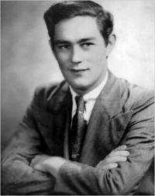
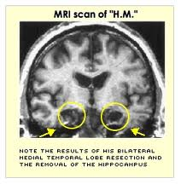
Patient “H.M.”
Had most of his hippocampus removed to stop a seizure disorder.
The surgery was successful, but he could no longer form new memories!
14

Slide 15
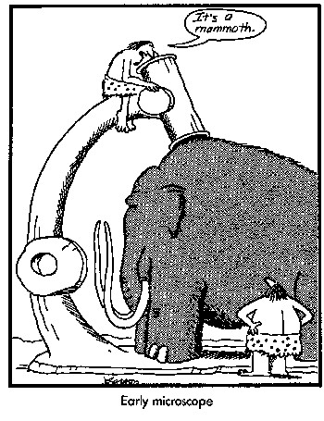
The importance of research
What causes brain disorders?
What do these disorders tell us about the brain?
Can we develop effective therapeutics to treat these disorders?

Slide 16
Mammalian Brain Size
Different animals have different sized brains
Some of them are small, some large, some are smooth some are not…
Can you figure out what animal these brains belong to?

Slide 17
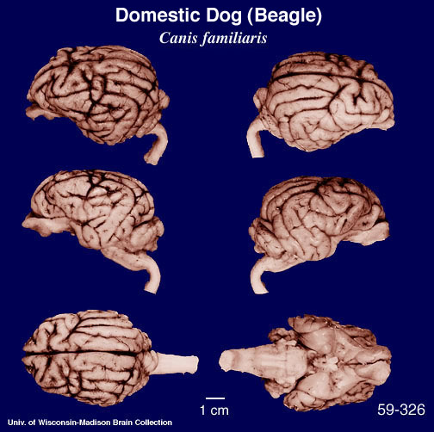
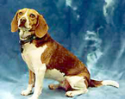
This is an animal you might find around your house, he’s got a great sense of smell and very good hearing… Give up?
It’s a dog!

Slide 18
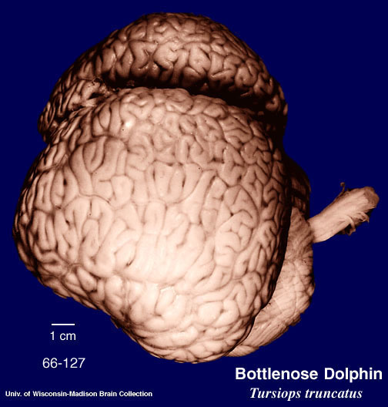
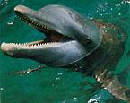
This animal is a great swimmer and communicates using high pitched calls… Figured it out?
It’s a dolphin! Their brains are even bigger than ours.

Slide 19
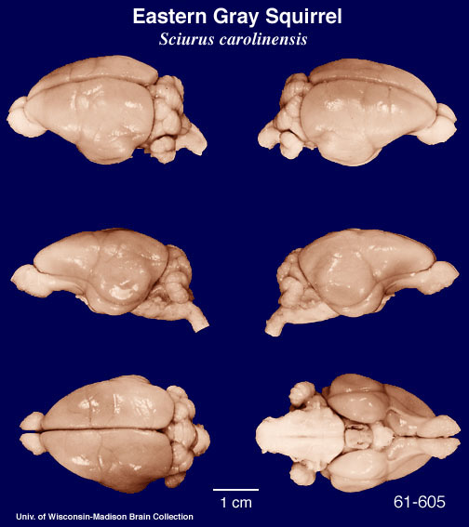
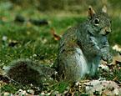
This animal might live in your backyard; they collect nuts and store them in nests inside of trees… Any Guesses?
It’s a squirrel! Do you see how smooth this brain is compared to the dolphin brain?

Slide 20
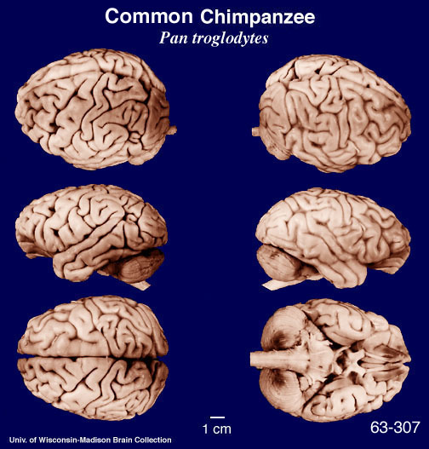
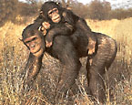
This animal lives in Africa and is our closest mammalian relative
It’s a chimpanzee! Look how similar their brains look to ours.

Slide 21
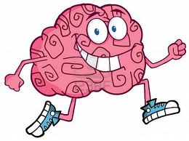
Protect your brain!
Now that you know all about the brain, how can you protect yours?
Wear your seatbelt!
Wear a helmet!
Get lots of sleep!
Exercise and Nutrition!

Slide 22
More great questions
What happens when a person is deaf?
When you are blind, is that an eye problem or a brain problem?
What happens when a person has a stroke?
Where do dreams come from and why can’t we remember all of them?
What is your subconscious?

Slide 23
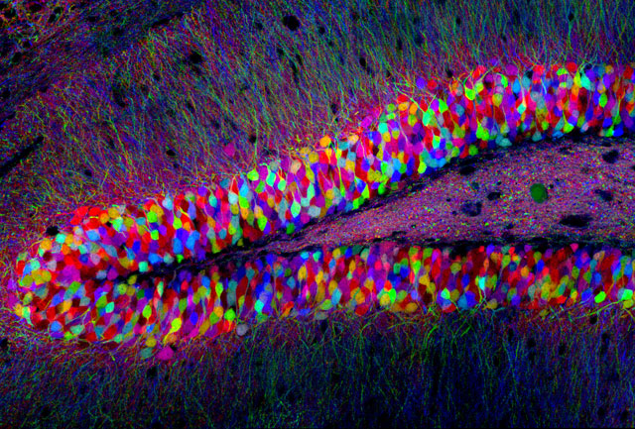
Thank you!!
Any more questions???

